Slide 1


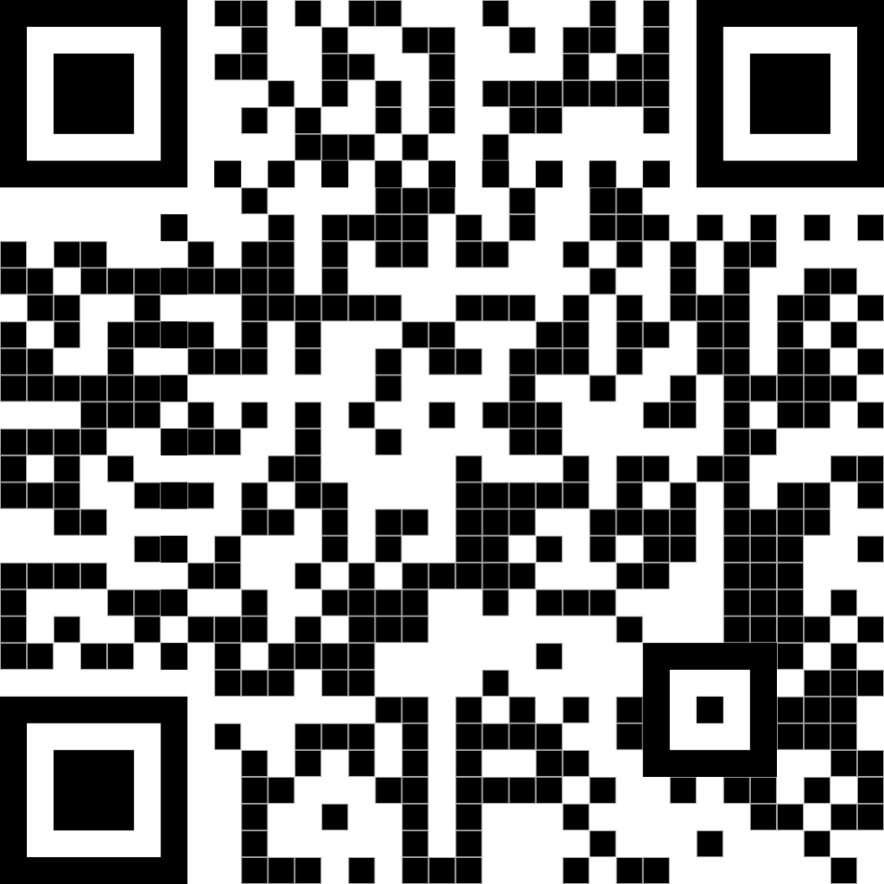
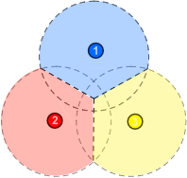
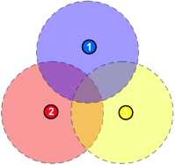
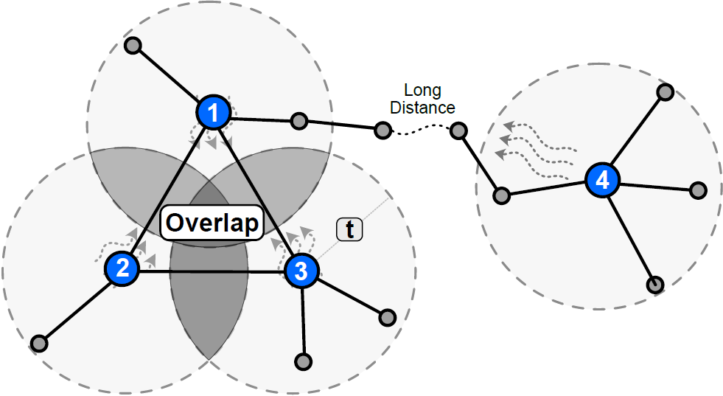
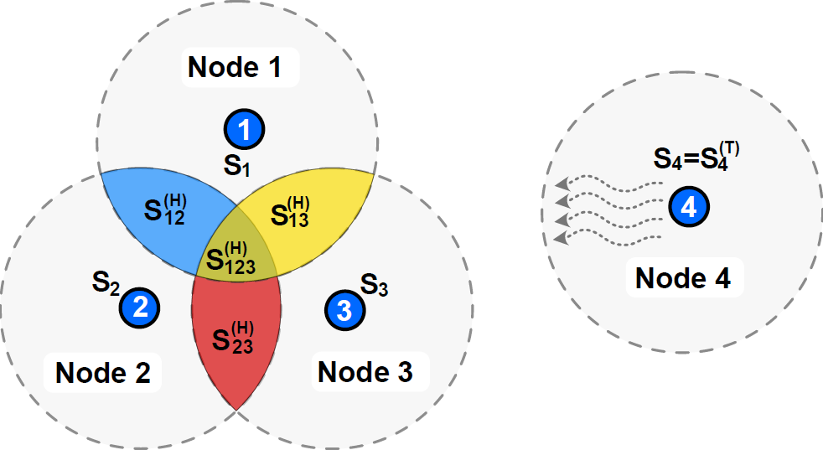
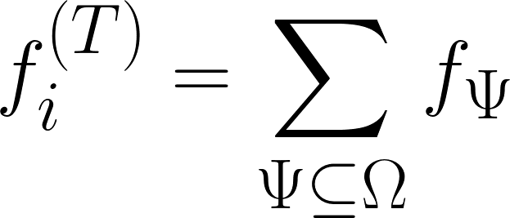
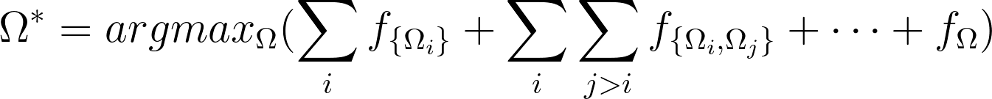
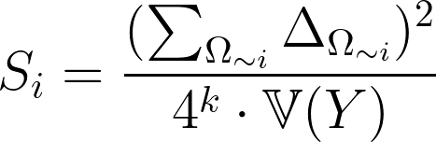

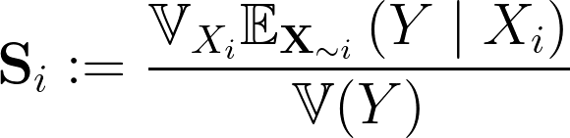
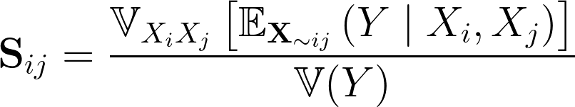
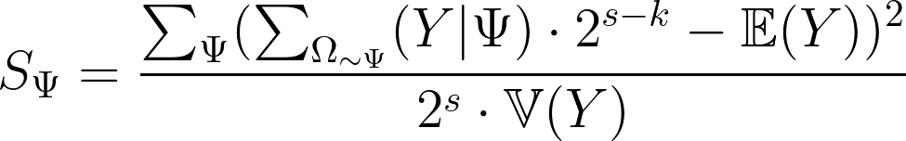
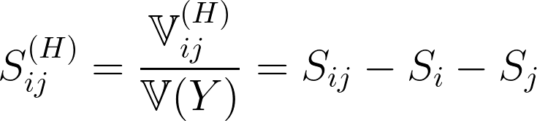
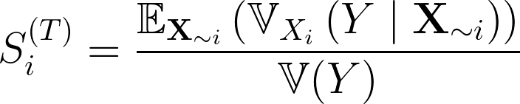
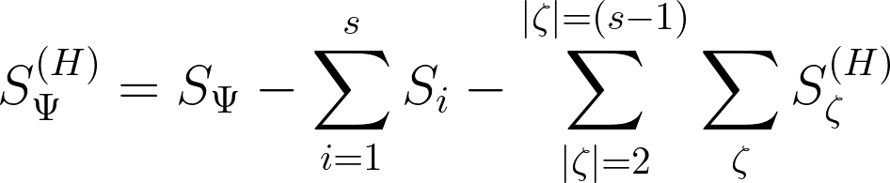
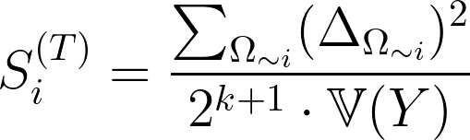
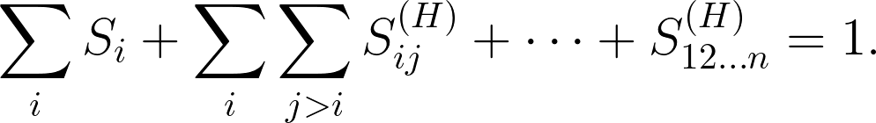
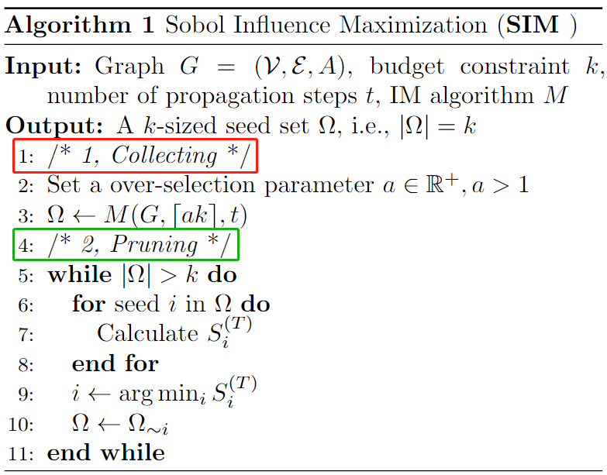
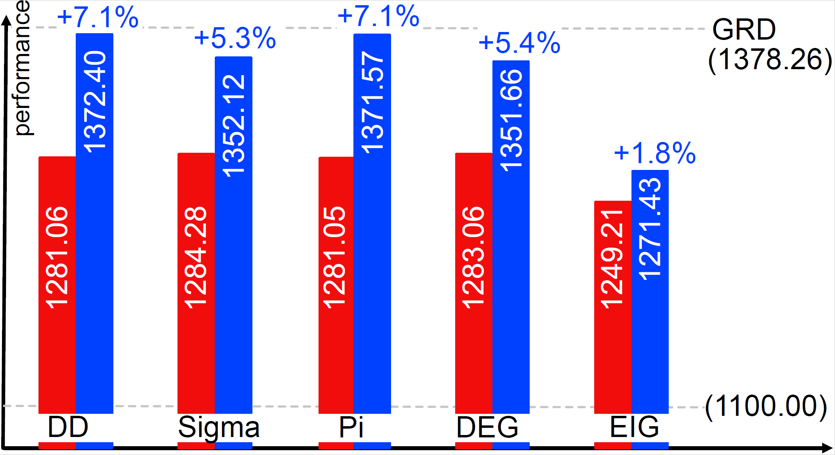
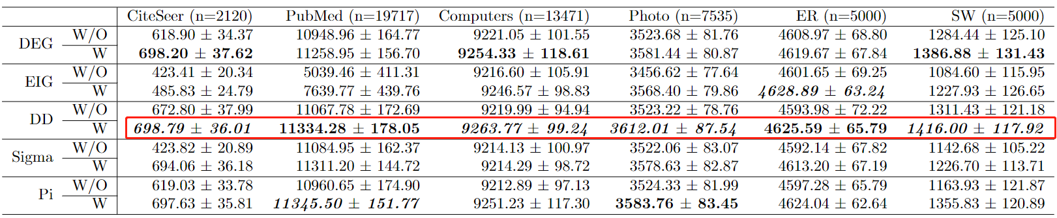
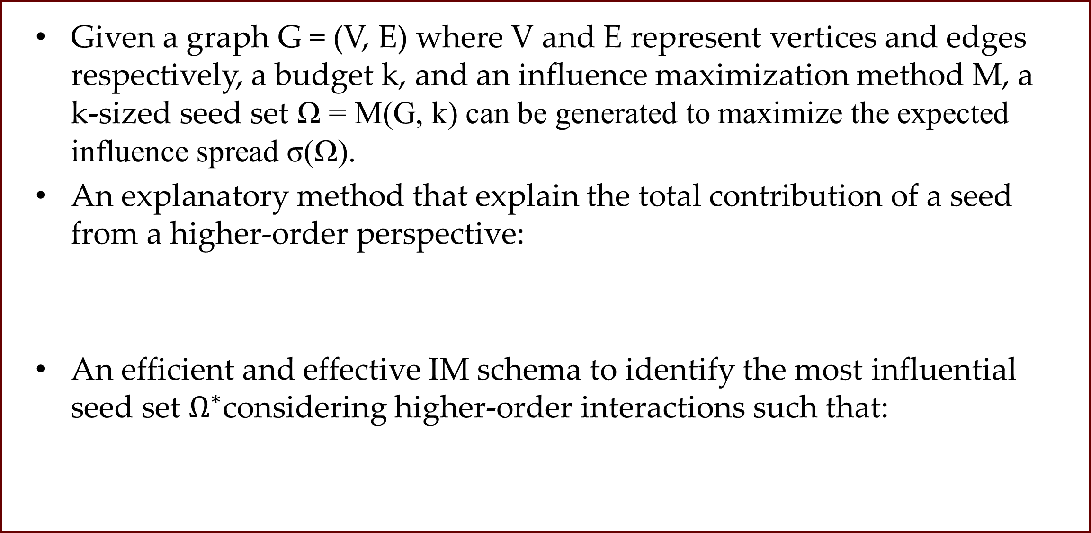
Understanding Influence Maximization via Higher-Order Decomposition
SIAM Data Mining 2023
Code Here ↑
My Website ↑
Zonghan Zhang, Zhiqian Chen
Computer Science and Engineering, Mississippi State University
Funded by the NSF IIS award # 2153369
Motivation
Comparing with Shapley Value
Influence Maximization: to find a set of seeds that maximizes the expected influence spread.
Two traditional streams of methods:
Simulation-based methods: too slow, not scalable
Proxy-based methods: cannot guarantee approximation ratio
Lack of tools for influence decomposition
LIME and Grad-cam, disregard the global impact.
Marginal contribution fails to quantify the interaction effects.
The Shapley value distributes the higher-order interaction equally among the seeds that involve in the interaction.
Underestimate the contribution of the seeds with larger interactions.
Main Contribution
The Shapley value (left) and how we want to evaluate the seed’s contribution (right)
Explain and decompose the influence spread of a seed set.
Provide a new IM schema that aims to balance effectiveness and efficiency by combining simulation and proxy.
Problem Setup
Given a graph G = (V, E) where V and E represent vertices and edges respectively, a budget k, and an influence maximization method M, a k-sized seed set Ω = M(G, k) can be generated to maximize the expected influence spread σ(Ω).
An explanatory method that explain the total contribution of a seed from a higher-order perspective:
An efficient and effective IM schema to identify the most influential seed set $Ω^{∗}$considering higher-order interactions such that:
Explanatory Method
Introduction to Sobol Indices: Section 4
IM: Section 5. Define seeds as binary variables and
The first-order contribution of a variable
The first-order contribution of a variable set.
The first-order contribution of a seed
The first-order contribution of a set of seeds
The second-order contribution of a variable
The total contribution of a variable in model
The higher-order contribution of interaction among the seeds in ψ
The total contribution of a seed to the spread
Sobol Influence Maximization (SIM)
Collecting: |ak| candidates are identified with SOTA proxy-based IM algorithms, where a is an arbitrary constant.
Pruning: Extra nodes with lower Sobol total index need to removed, one at a time.
Time complexity: assuming a is a fairly small integer constant, while k and r do not expand with the problem size.
Empirical Experiments
Note that combining the degree discount heuristic with SIM always achieves the best or the second best.

